Slide 1
Face Emotion RECOGNITION
--Raghavendra Choudhary

Slide 2
AGENDA
Introduction​
Problem Statement
​Data Preprocessing
Model Building and Evaluation
Model Deployment
​Summary​

Slide 3
Introduction:
While digital platforms have limitations in terms of physical surveillance, it comes with the power of data and machines, which can work for you.
It provides data in form of image, video, audio, and texts, which can be analyzed using deep learning algorithms. A deep learning-backed system not only solves the surveillance issue, but also removes the human bias from the system, and all information is no longer in the teacher’s brain but rather translated into numbers that can be analyzed and tracked.

Slide 4
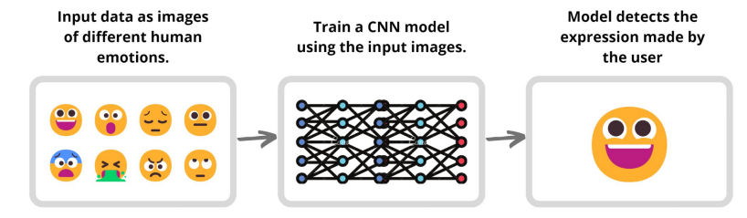
Problem statement:
We aim to solve one of the challenges faced by digital platforms by applying deep learning algorithms to live Images data.
We do this by recognizing the facial emotions of the participants using the CNN model we create which will categorize the observed emotion accordingly.

Slide 5
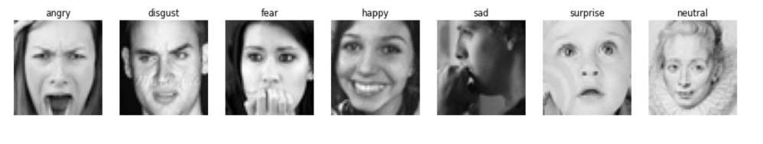
Dataset used:
We have utilized the FER 2013 dataset provided on Kaggle.
The data consists of 48x48 pixel grayscale images of faces.
The faces have been automatically registered so that the face is more or less centered and occupies about the same amount of space in each image.
The training set consists of 28,709 examples and the public test set consists of 3,589 examples.

Slide 6
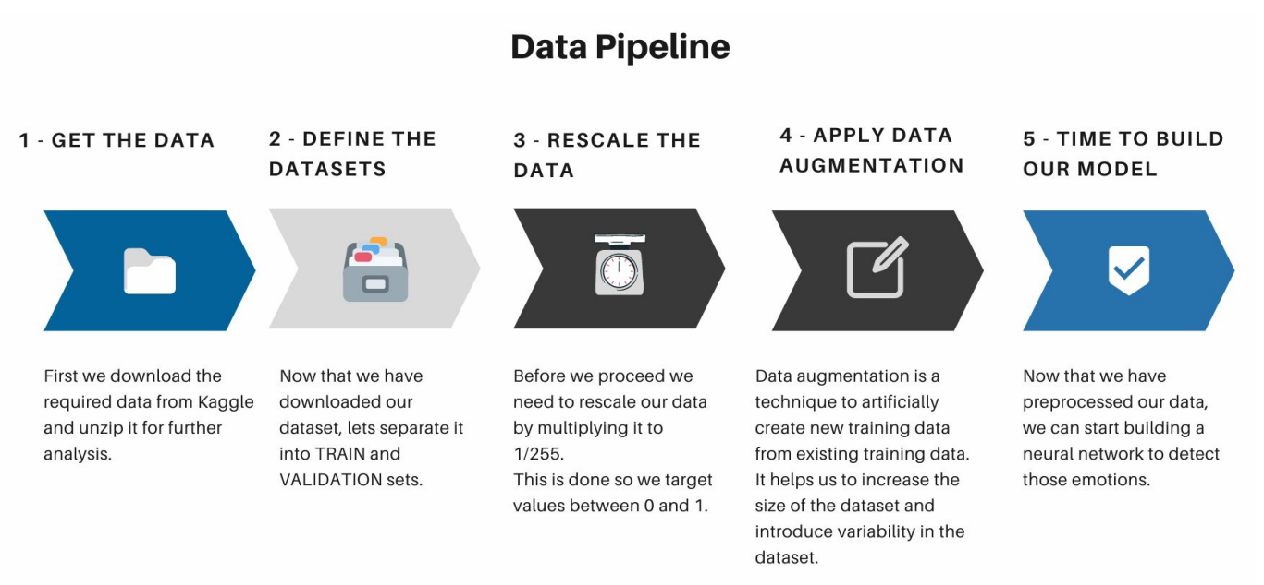
Data Preprocessing:

Slide 7
Model Building and Evaluation:
“
”
Convolutional Neural Network (CNN):
A neural network is a way for a computer to process data input. They’re inspired by biological processes found in human and animal brains. Neural networks are comprised of various layers of ‘nodes’ or ‘artificial neurons’. Each node processes the input and communicates with the other nodes.
In this way, input filters through the processing of a neural network to create the output, or answer. Convolutional neural networks were inspired by animal vision. The way the nodes in a CNN communicate with each other resembles the way some animals see the world. So, rather than taking everything in as a whole, small areas of an image are taken. And these small areas overlap to cover the whole image.

Slide 8
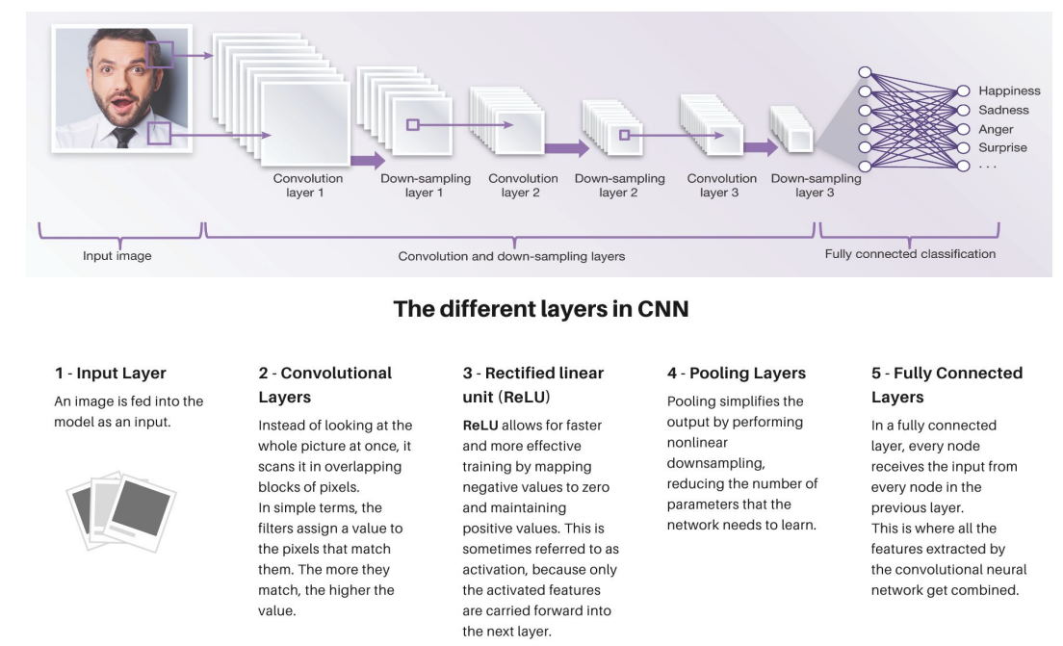
What happens inside an CNN?

Slide 9
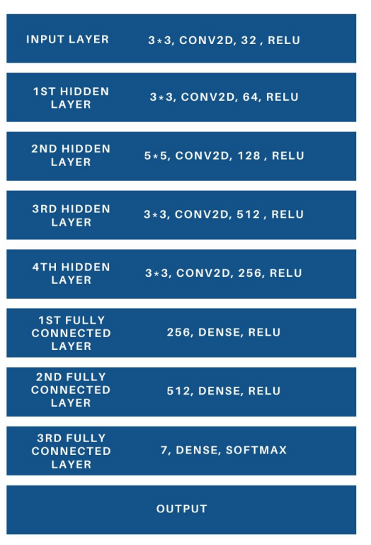
Custom CNN model for recognizing facial emotions:
To achieve our aim to recognize the facial emotions of a user, we created a CNN model using Keras and Tensorflow libraries.
The neural network contained an input layer, four hidden layers, and three fully-connected layers to process the image data and predict the emotions.
In between each layer, a Max Pooling and Dropout layer was added for downsampling the data and preventing our model from overfitting.

Slide 10
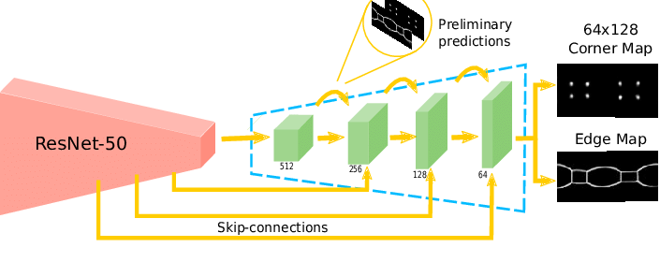
ResNet-50 Architecture:
ResNet-50 is a convolutional neural network that is 50 layers deep. ResNet, short for Residual Networks is a classic neural network used as a backbone for many computer vision tasks.
The fundamental breakthrough with ResNet was it allowed us to train extremely deep neural networks with 150+layers. It is an innovative neural network that was first introduced by Kaiming He, Xiangyu Zhang, Shaoqing Ren, and Jian Sun in their 2015 computer vision research paper titled ‘Deep Residual Learning for Image Recognition’.
Convolutional Neural Networks have a major disadvantage — ‘Vanishing Gradient Problem’. During backpropagation, the value of gradient decreases significantly, thus hardly any change comes to weights. To overcome this, ResNet is used. It make use of “SKIP CONNECTION”.

Slide 11
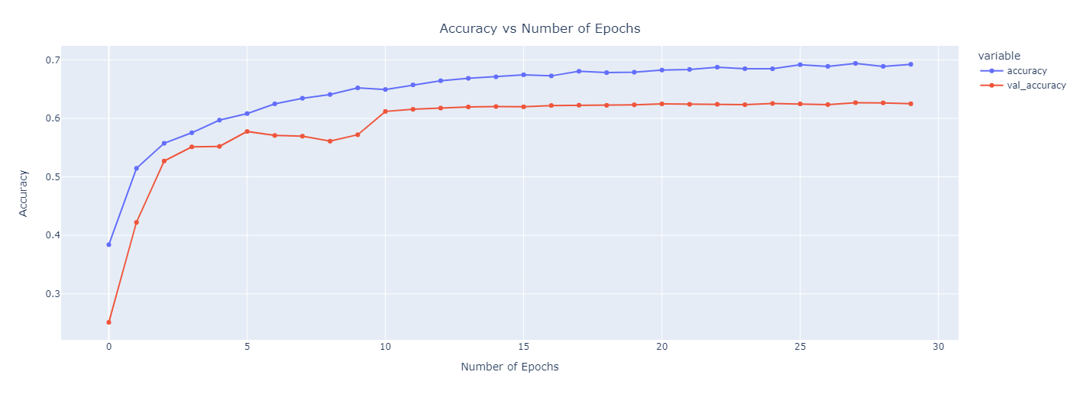
Plots for accuracy and loss
The created model was run for 30 epochs in order to get an accuracy of 69.24% on training set and 62.50% on validation set.

Slide 12
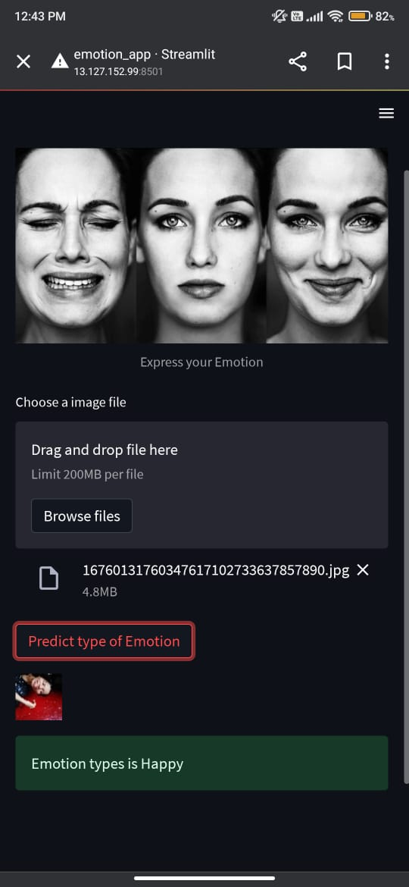

Real Time Facial Emotion Detection:
It was also capable of detecting multiple faces and their respective emotions successfully.
The face detection was done using OpenCV, and the output was displayed on the webpage using Streamlit package

Slide 13
SUMMARY
We successfully achieved our objective and created a model capable of recognizing seven different classes of emotions mentioned in the dataset.
For it to be accessible by others, a web app was created using OpenCV and Steamlit library.
Both locally deployed app and the webapp can recognize the facial emotions of a user using the webcam of his/her laptop or computer

Slide 14
THANK YOU
Raghavendra Choudhary 21ds.raghavendra@iscm.ac.in

